Slide 1



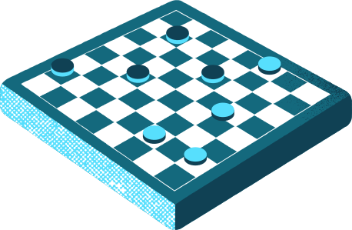
CHEKERS GAME USING AI
Team:
Snehal Suryavanshi
Aditya Shirsath
Siddhi Phapale
Swati Sonone
Guide :
Prof. G Bhutkar

Slide 2

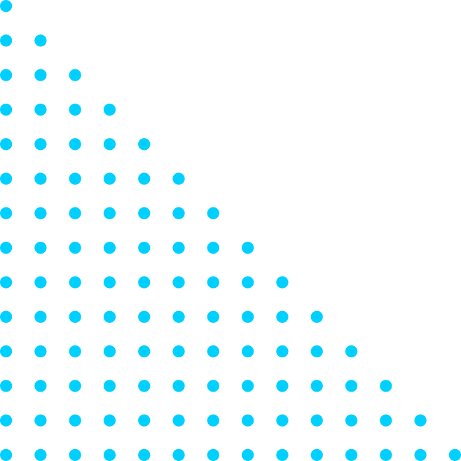
INTRODUCTION
Classic Gameplay Meets Tech: We're bringing the timeless joy of checkers into the digital realm.
AI Opponent: Introducing a 1-player AI for an added layer of challenge and unpredictability.
Blend of Tradition and Tech: Explore the seamless integration of traditional gameplay with cutting-edge AI.
Enhanced Gaming Experience: The AI opponent tests players' skills, elevating the overall gaming experience.
Let the game begin!

Slide 3

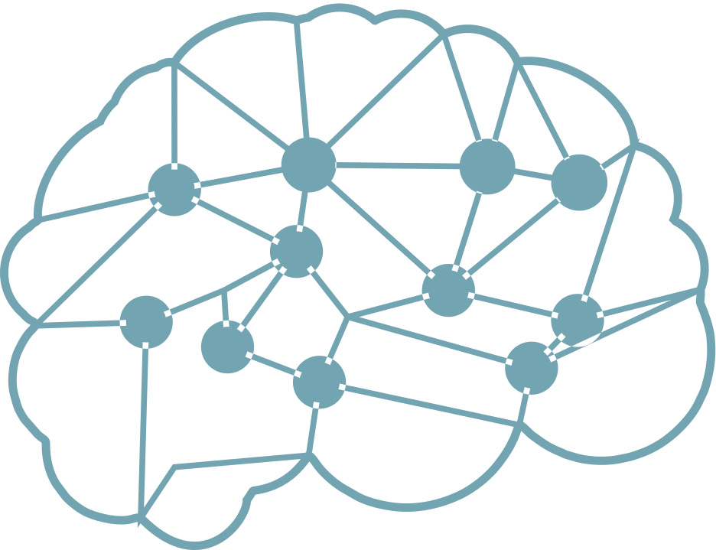

01
GAME RULES
Piece Movement:
Players take turns moving their pieces diagonally forward.
Regular pieces move one square at a time.
Pieces can only move to an empty square.
Diagonal movements can be left or right.
Capturing:
Capturing is mandatory if a player's piece can jump over an opponent's piece.
Captured pieces are removed from the board.
Multiple captures can be made in a single turn (chaining).
King Promotion:
When a regular piece reaches the opponent's back row, it is promoted to a king.
Kings can move both forward and backward diagonally.
King promotion opens up strategic possibilities for players.

Slide 4

SOLUTION
1
2
AI ALGORITHUM
ALPHA BETA PRUNING
Minimax Algorithm Overview:
Objective: The aim is to find the optimal move for the AI opponent, maximizing its chances of winning or minimizing the chances of losing.
Evaluation Function: An evaluation function assesses board states, assigning scores based on the favorability for the AI player.
Depth-Limited Search: To manage complexity, the algorithm conducts a depth-limited search, exploring a set number of moves ahead, considering both AI and human player moves.
Alpha-Beta Pruning Overview:
Efficiency Boost: Alpha-beta pruning is a technique that enhances efficiency by discarding unexplored branches of the search tree.
Alpha and Beta Values: Alpha is the best score the AI player can guarantee (maximum), while beta is the best score the opponent can guarantee (minimum).
Pruning Condition: If a move leads to a score worse than the current best-known score during the search, the algorithm prunes that branch, avoiding unnecessary exploration of unpromising paths.

Slide 5

MOVE GENERATION
EVALUATION
The evaluation function assesses board states based on factors such as piece count, king promotion, and piece positioning. The scoring system aims to capture strategic advantages for the AI player.
The algorithm generates possible moves for the AI player and evaluates each move's consequence on the game state
IMPLEMENTATION
DECISION MAKING
RECURSION
The minimax algorithm works recursively, exploring possible moves at different depths, simulating the AI player and the opponent taking turns.
The algorithm decides on the best move by considering the scores associated with each possible move, factoring in the opponent's responses.

Slide 6


CONCLUSION
FUTURE FOCUS
PROJECT SUCCESS
Continuing to enrich player experience by incorporating feedback and exploring enhancements for sustained success and broad appeal.
Classic gameplay meets modern AI in our checkers game with a 1-player opponent, featuring robust rules, an intuitive interface, and efficient AI algorithms.

